Slide 1
P.P.E
Fundamental of Open Source SW Project
Class 2
Team 3

Slide 2
Contents
Team
Project
Q&A

Slide 3
01.
Team

Slide 4
Team
One-Blue
GUI
Eun-Seo Lee
Yoon-Min Jeong
Background
You-Bin An
Woo-Hyeok Jin
Ji-Min Ha

Slide 5
02.
Project

Slide 6
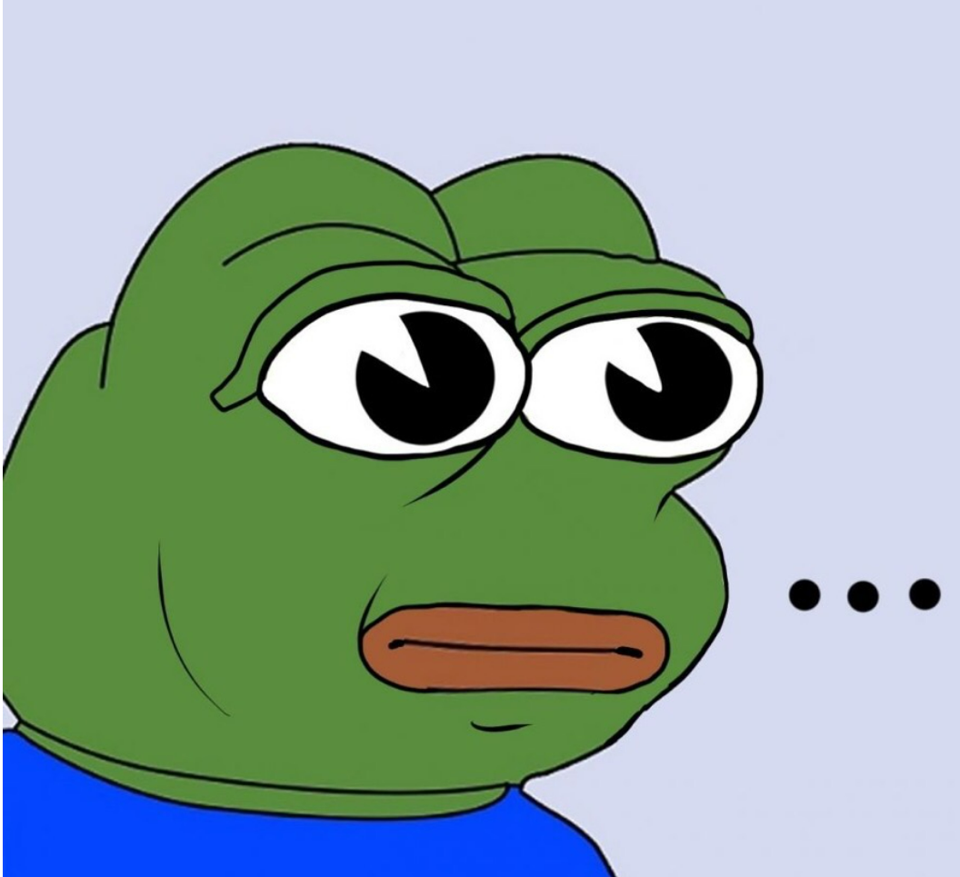
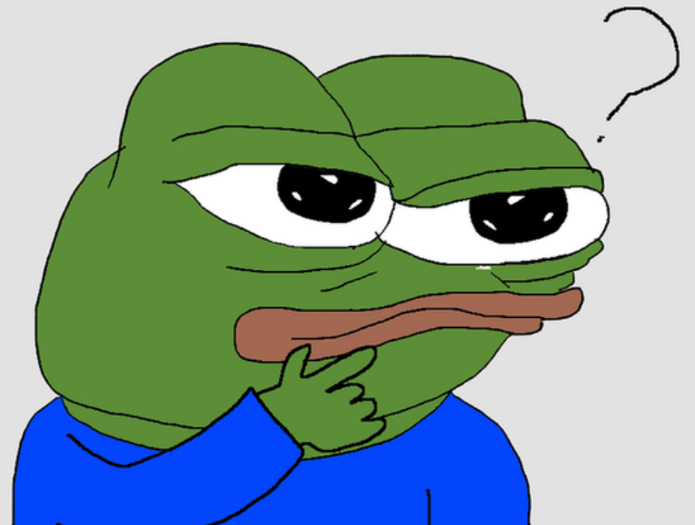
Motivation
What should I study specifically?
Am I know it right…?

Slide 7

P.P.E (Python Programming Education)
Mascot of P.P.E

Slide 8
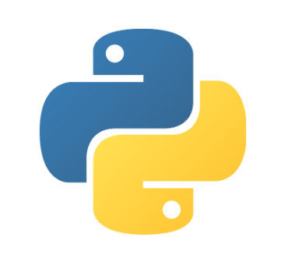

P.P.E (Python Programming Education)
Educational Language
: Python
Used Python Modules
: tkinter(main) = GUI,
webbrowser = URL,
Time = Date,
winsound = Sound

Slide 9
Core Features
Python grammar
Organized by chapter
Include typing code page
Quiz
Check what user has learned
Character
Growth according to the degree of learning

Slide 10
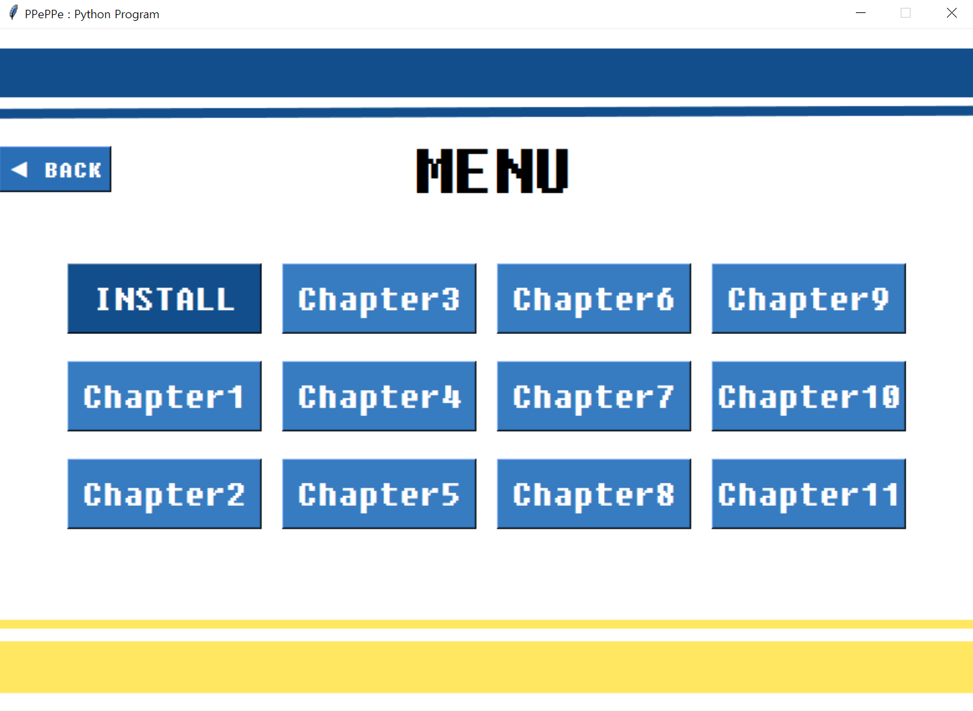
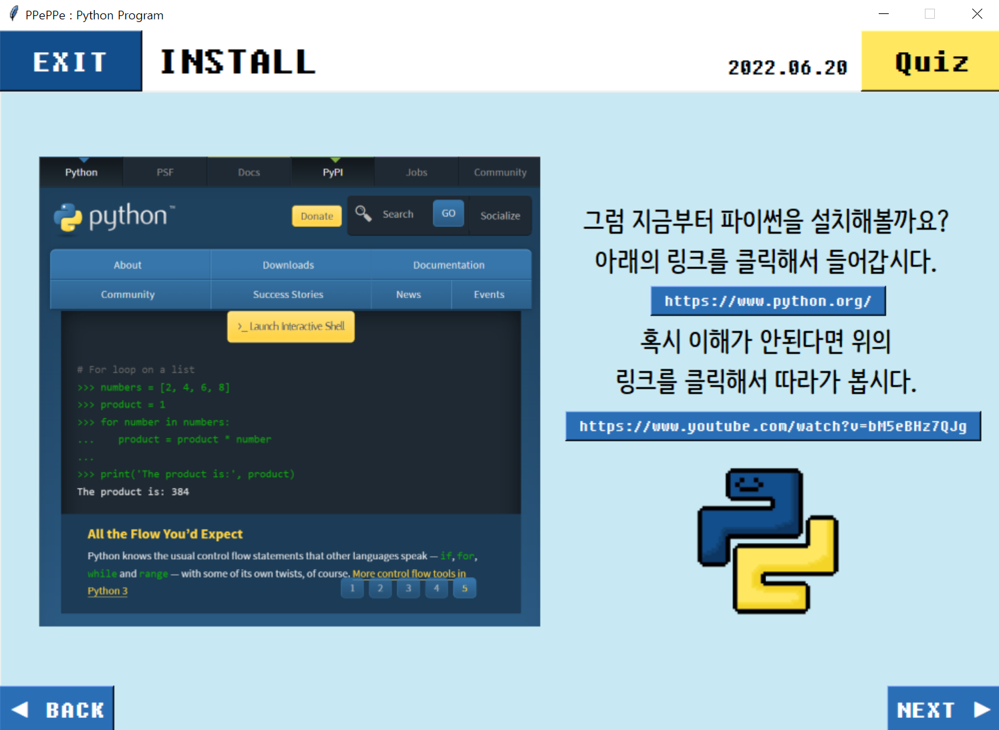
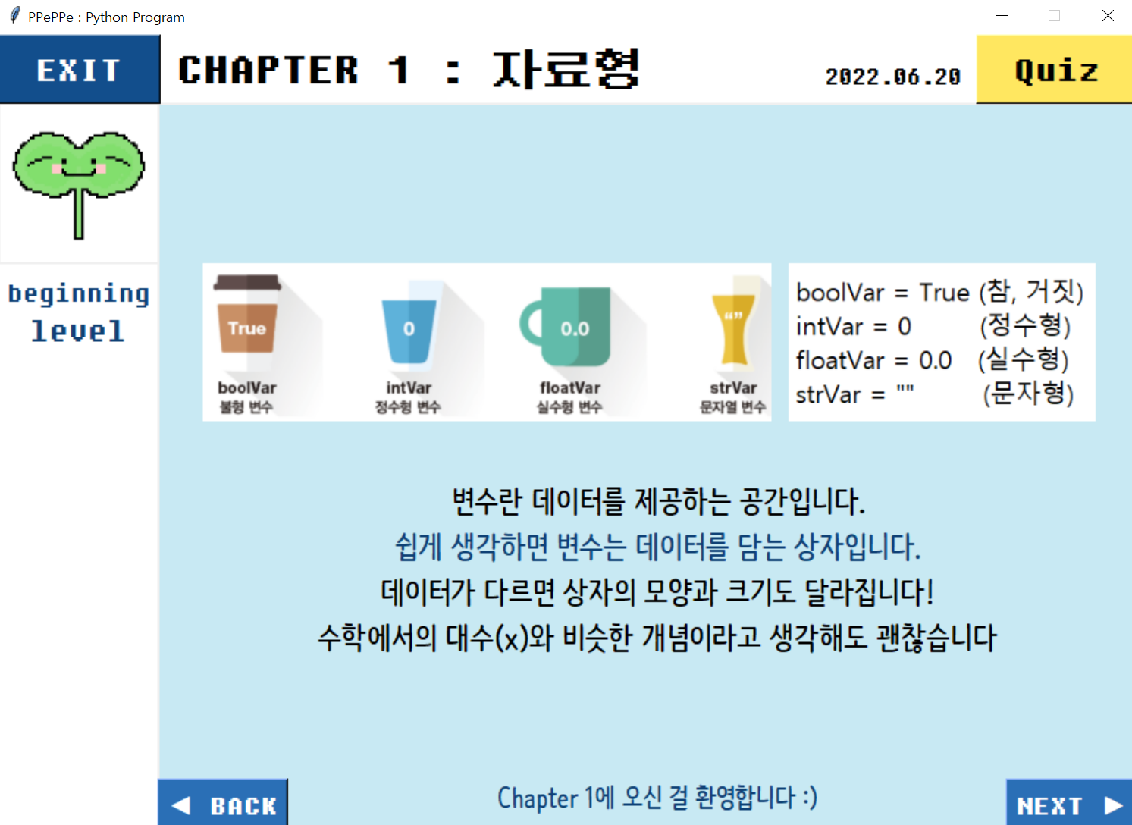
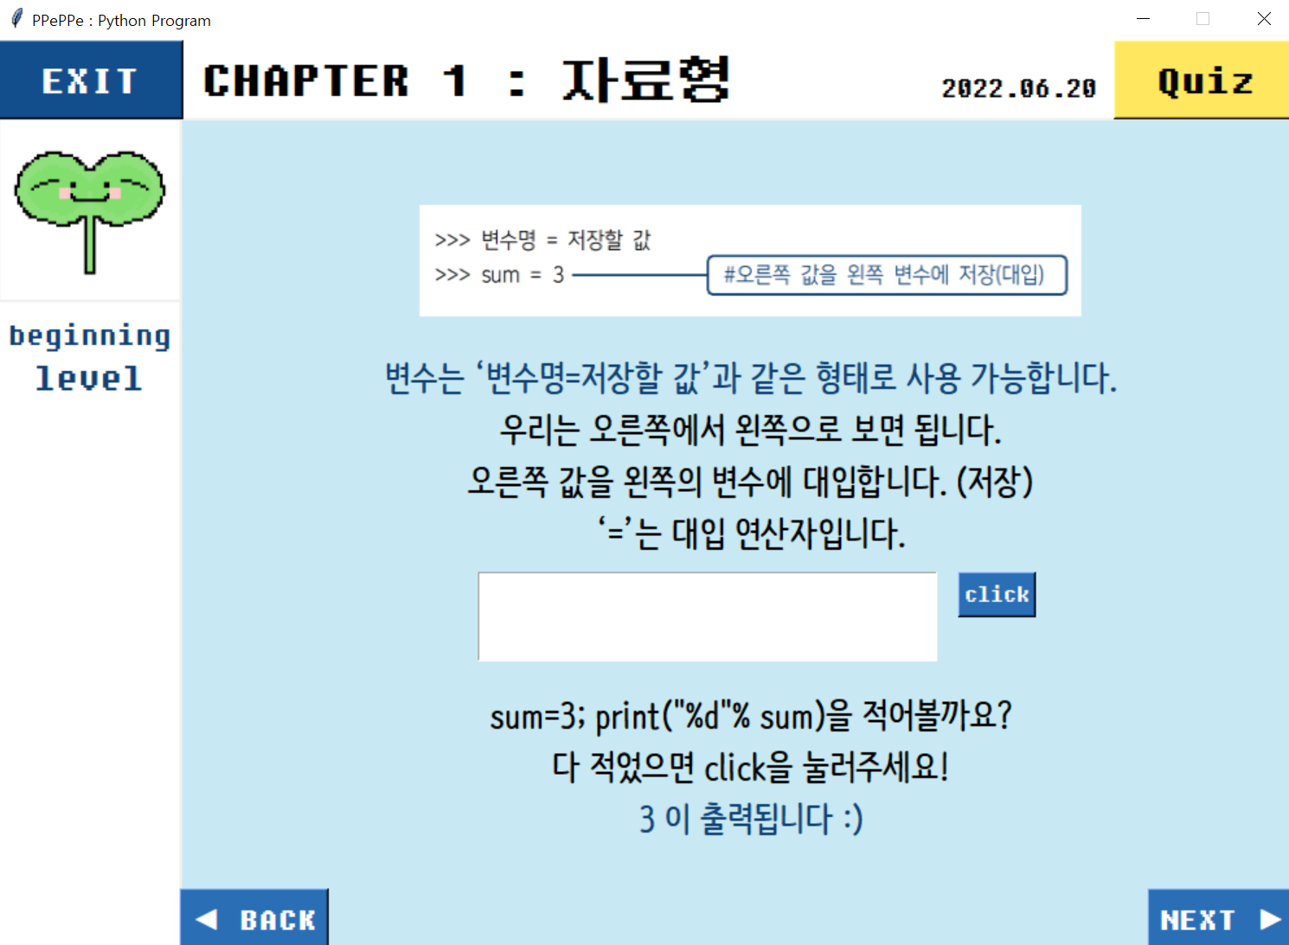
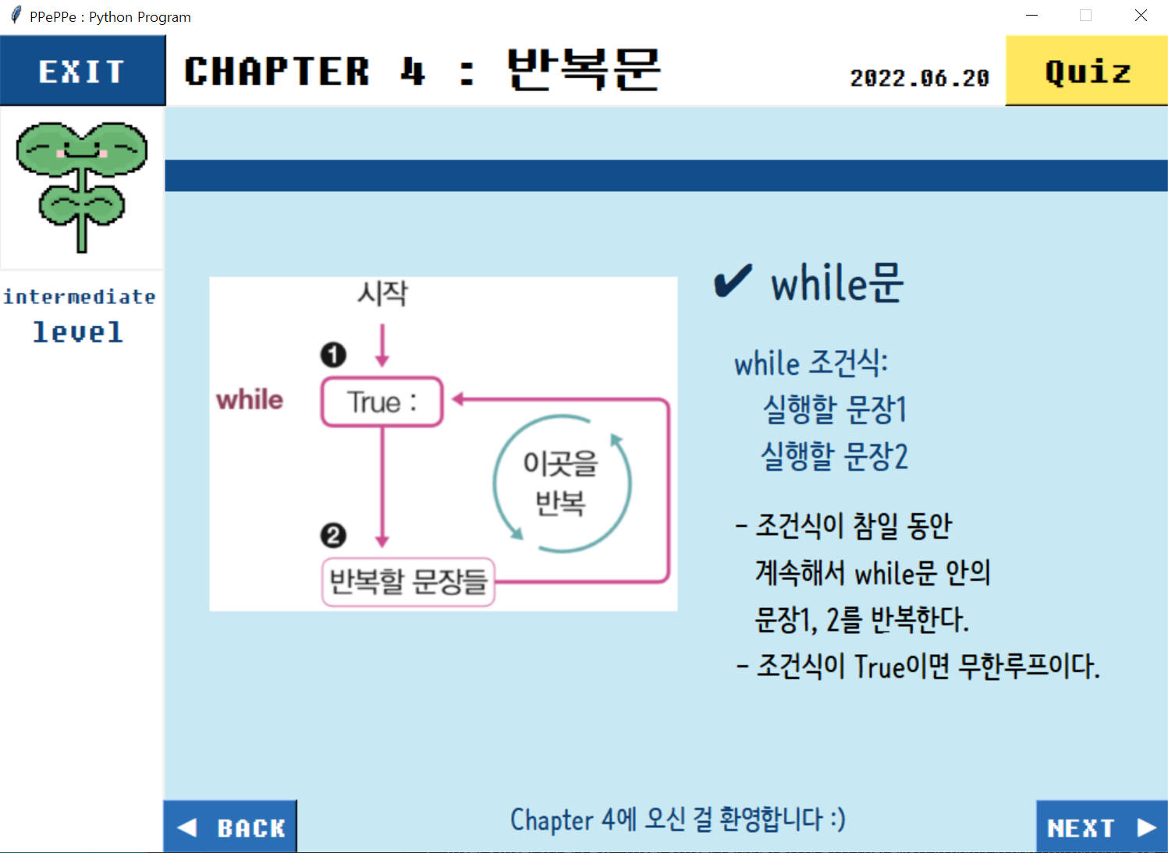
Features – Python grammar

Slide 11
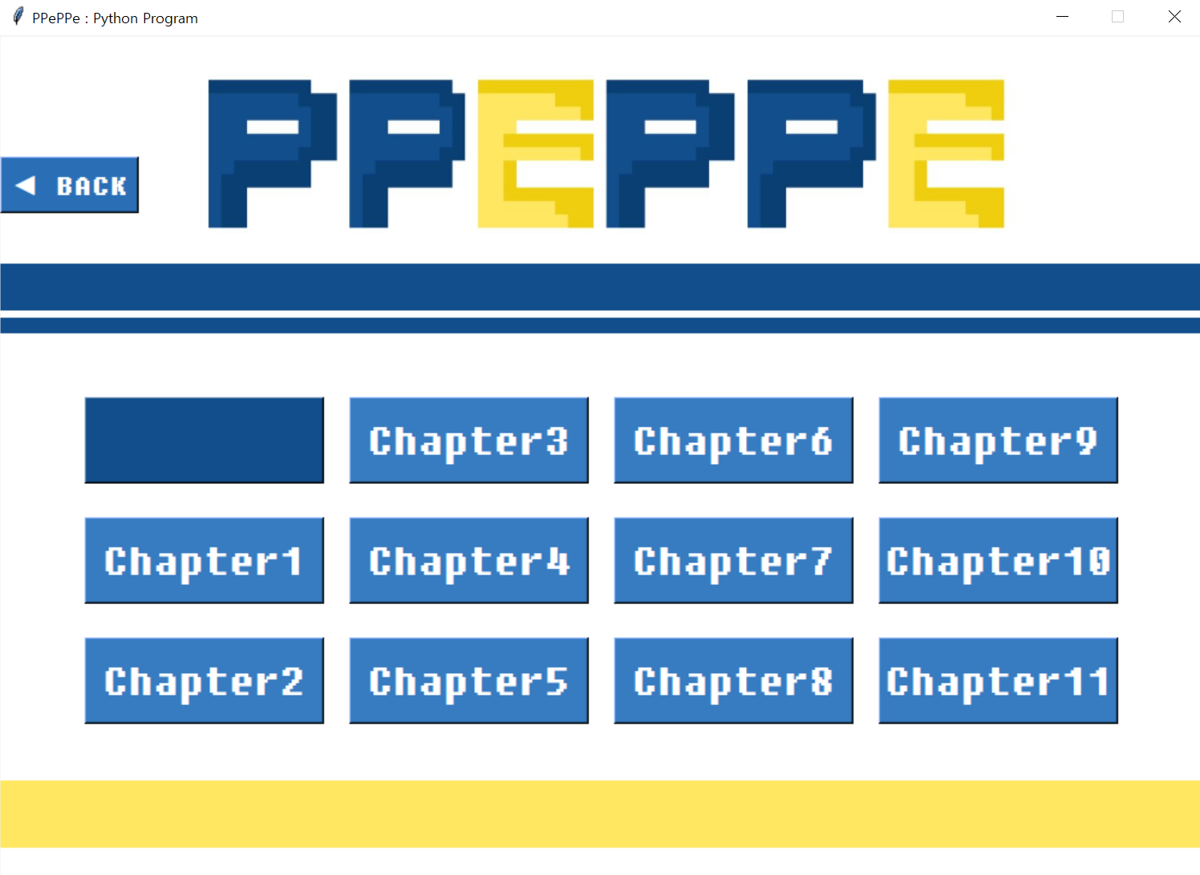
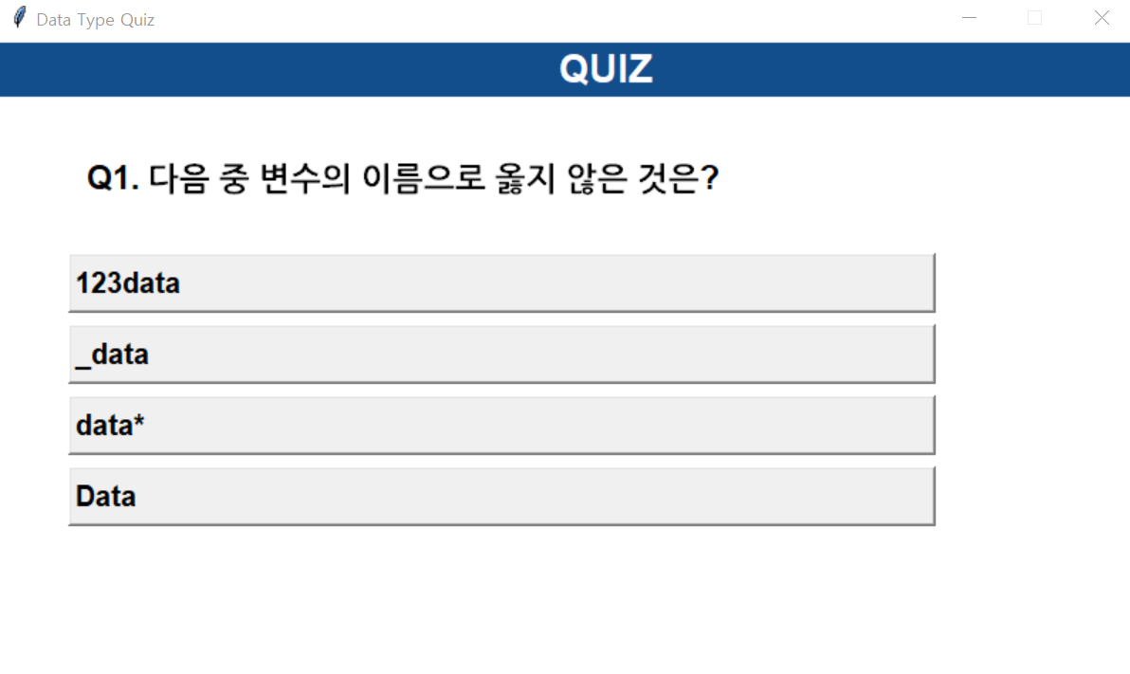
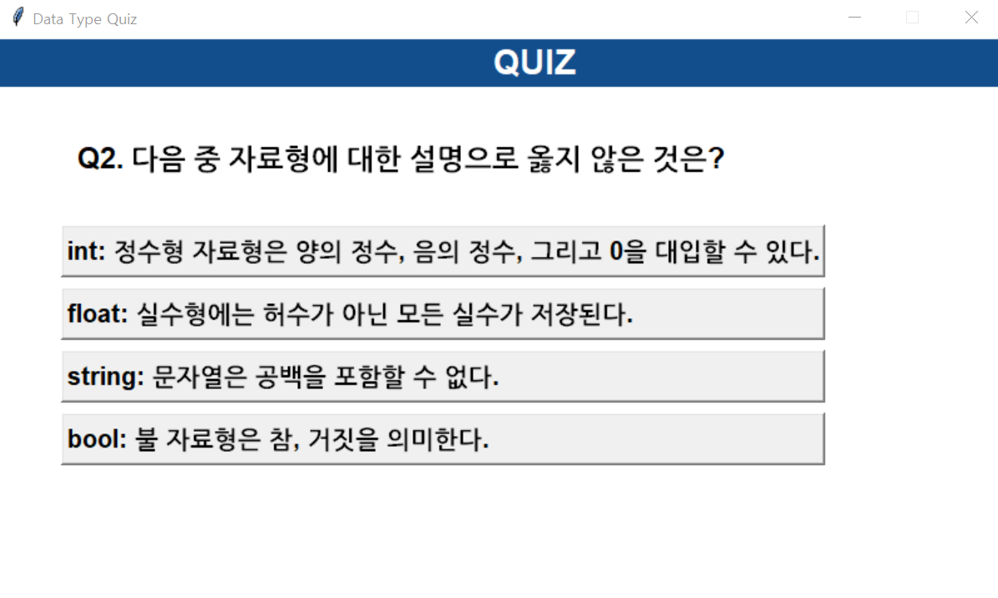
Features - Quiz

Slide 12
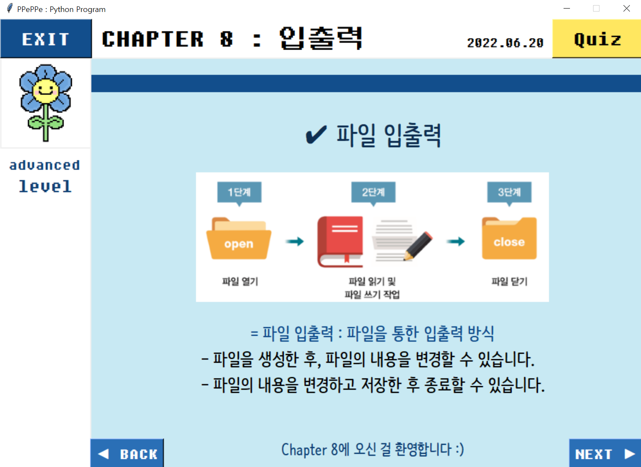



Features - Character

Slide 13
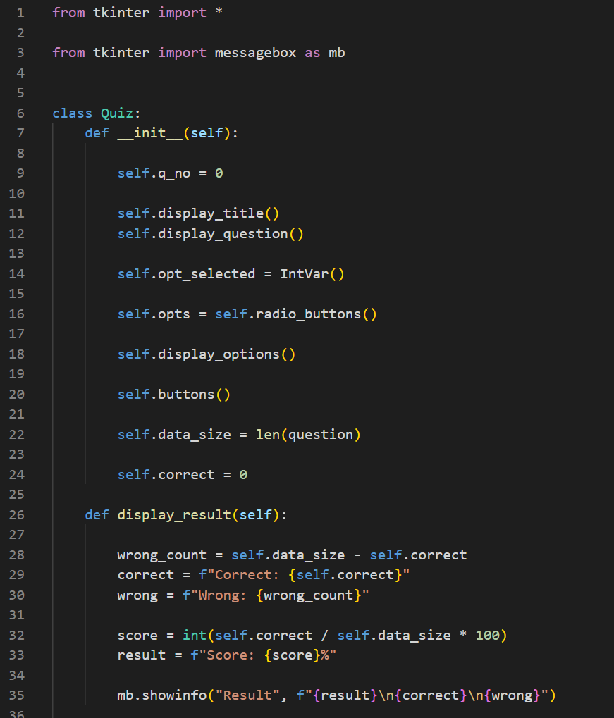
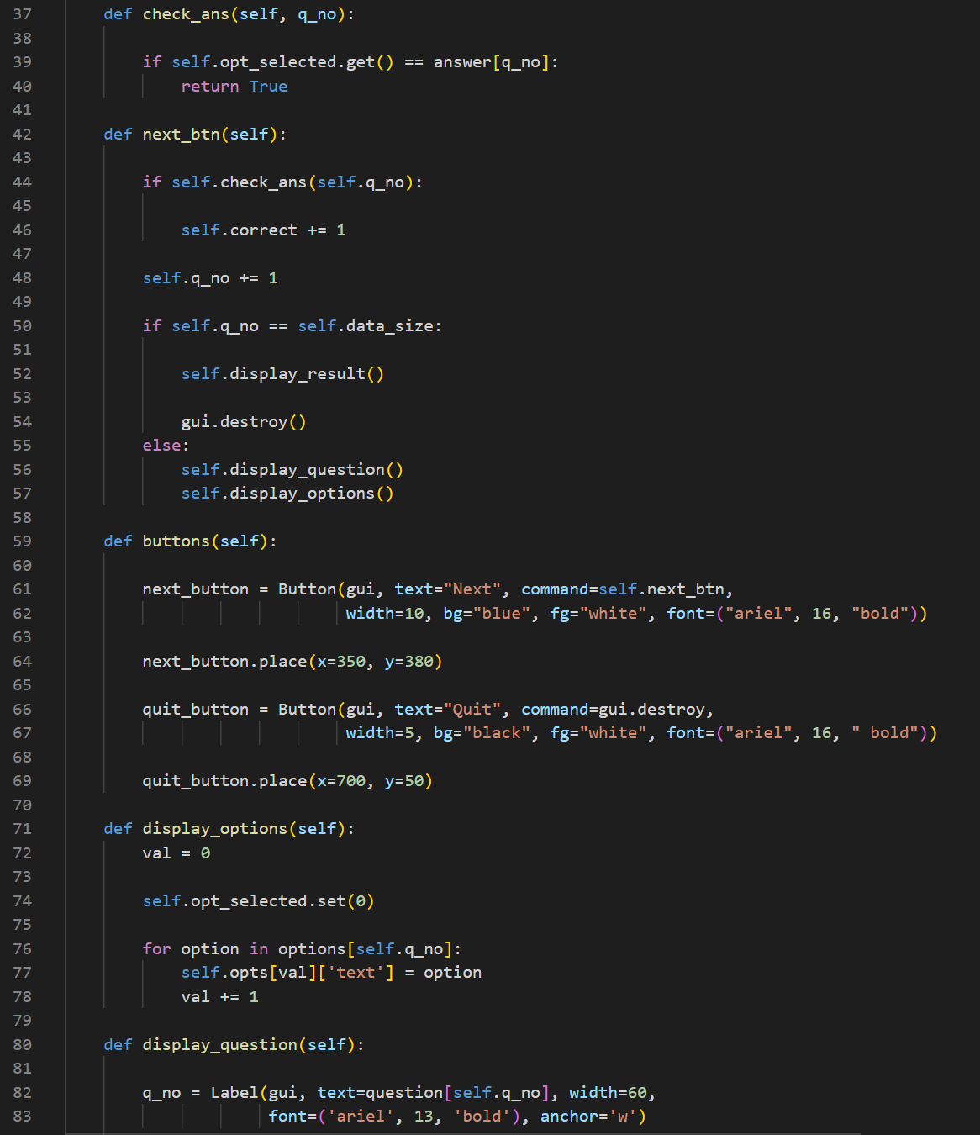
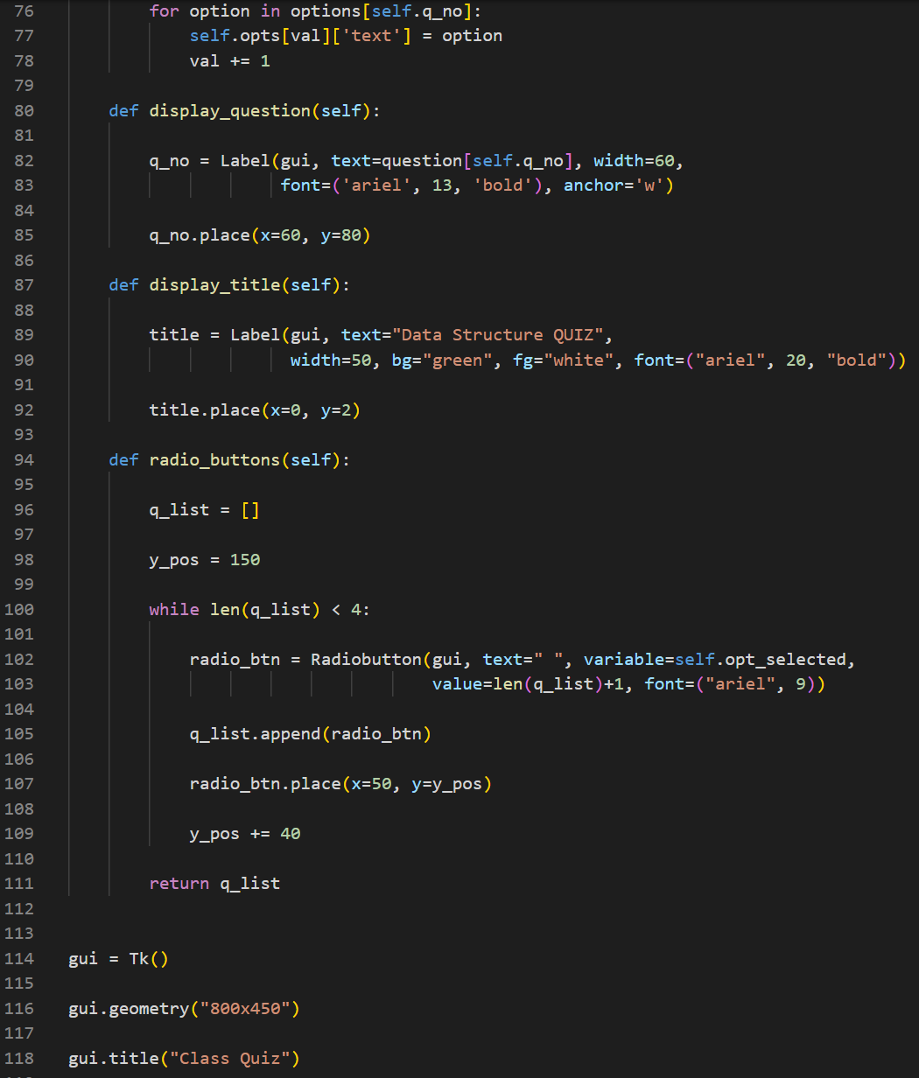
Used Open Sources
Make Quiz
: https://www.geeksforgeeks.org/python-mcq-quiz-game-using-tkinter/
Open Webbrowser
: https://codechacha.com/ko/python-open-webbrowser/

Slide 14
Difficulties - 1
A return button did not work
Repetition of destroy() and pack()
Frame that proceeded destroy() cannot execute pack()
Overlapping frames by using grid() and raise() to make it look like a screen changed.
The image remained the same,
when we tried to switch the screen by tkrise().

Slide 15
Difficulties - 2
To solve this problem, we use class that we found through google search
But when we put the pictures in, they were not appeared
we made a copy by the original list and tank list
so that we can use pack() again even if we use destroy() to it
If we use destroy() to copy of the list, the original was corrupted
Use pack_forget() and place_forget() instead of destroy()

Slide 16
If we upgrade P.P.E
Increasing the kinds of character and the number of quizzes
Creating a store related to characters and quiz hints

Slide 17
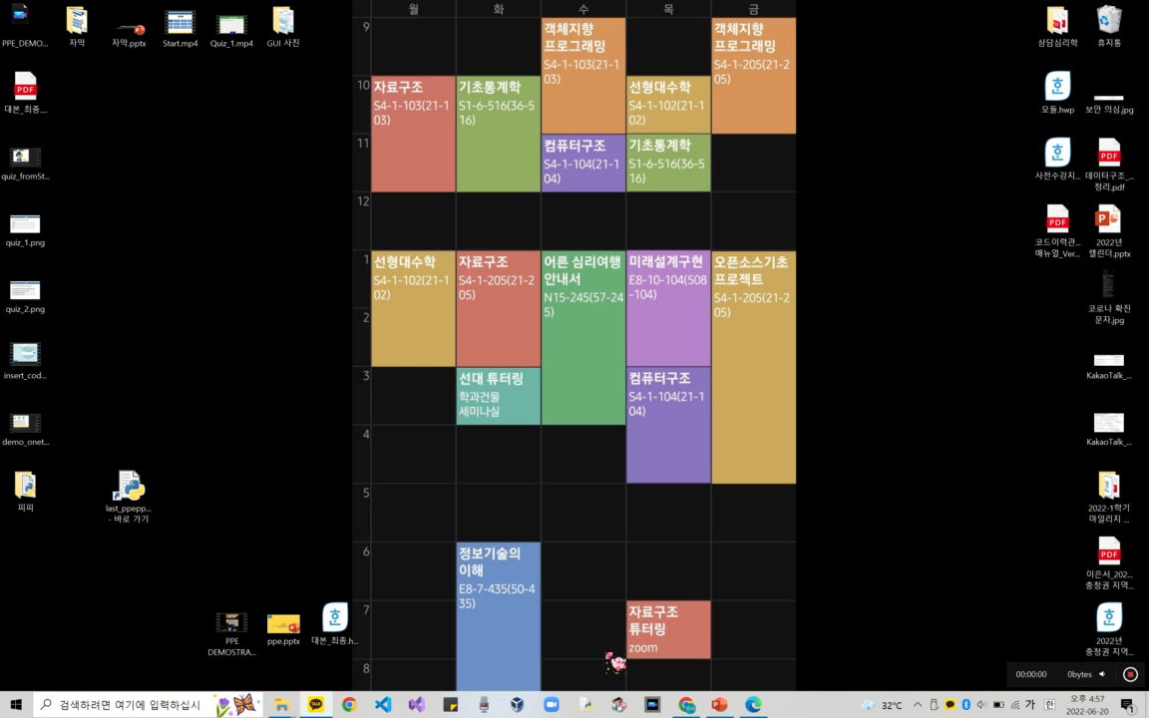
Demonstration

Slide 18
Q&A
Any Question?

Slide 19
Thank you
Github: https://github.com/Jinnuu/jinn.git

